Slide 1


SAP UI5 & FIORI with OData TRAINING
Anubhav Oberoy
Day – 26

Slide 2

Agenda – Day 26
Deploy to SAP Fiori Launchpad
Analytic List Page
Overview page App

Slide 3
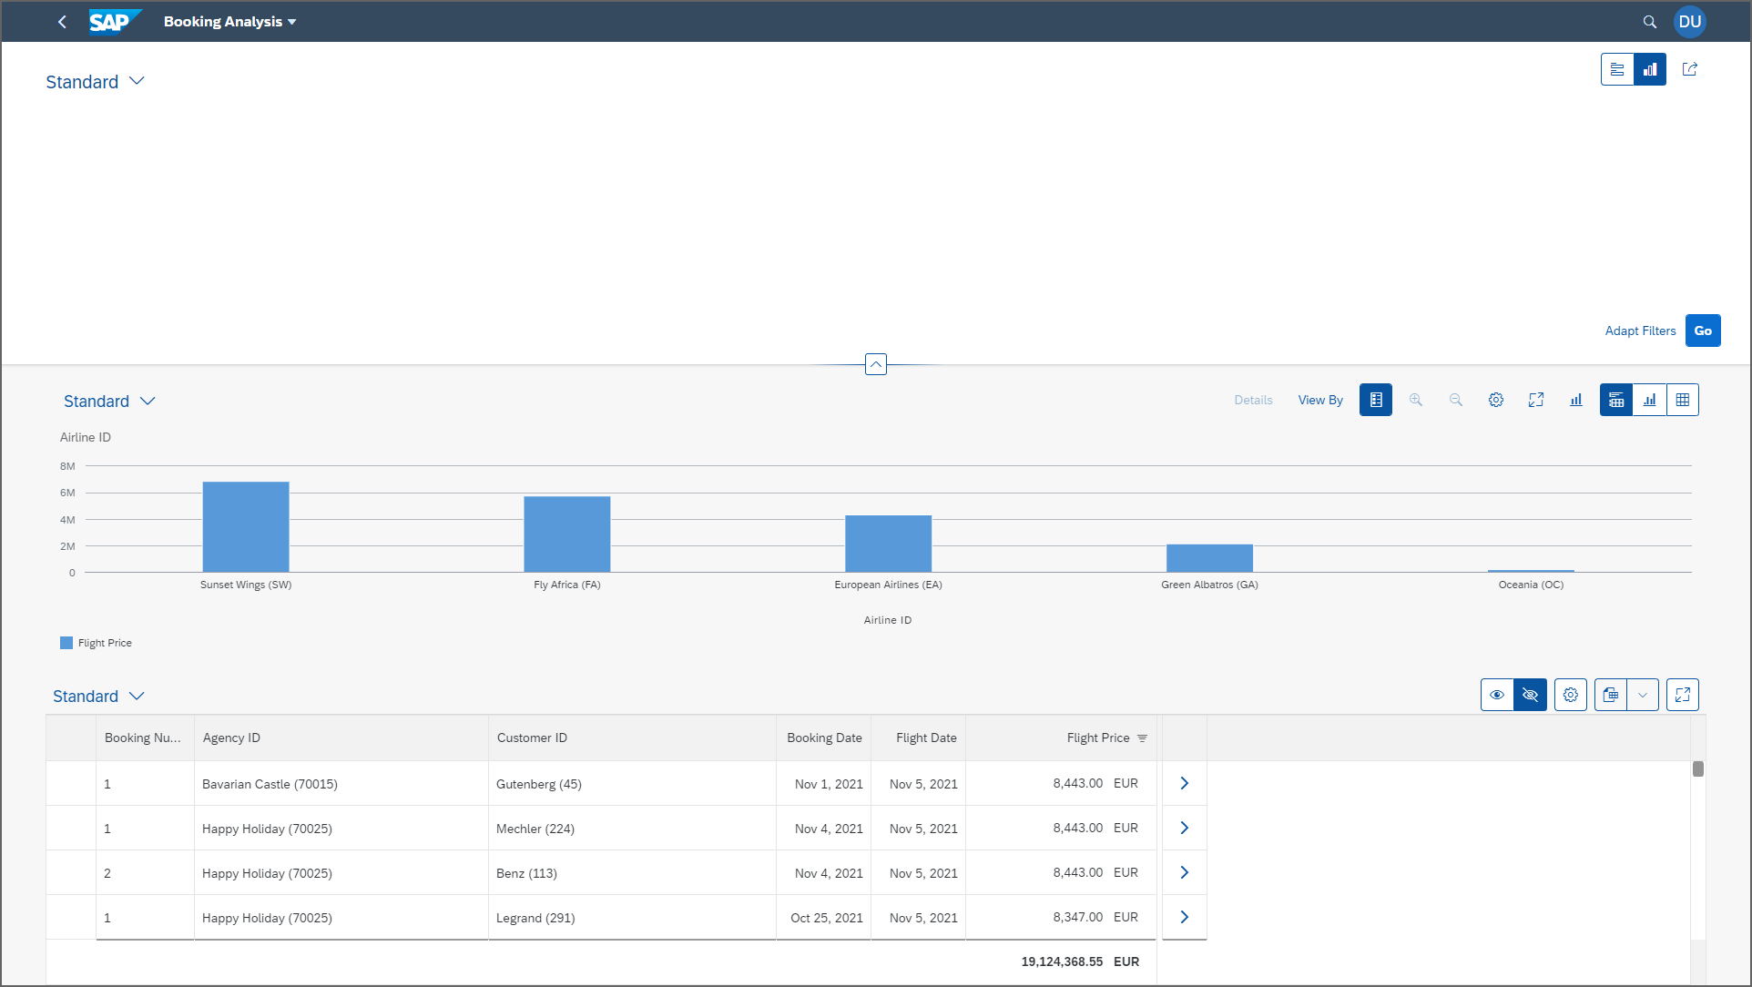
Create Analytic List Page

Slide 4
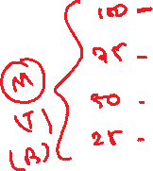

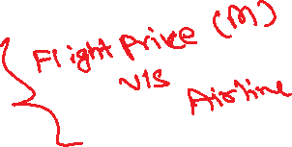










Slide 5
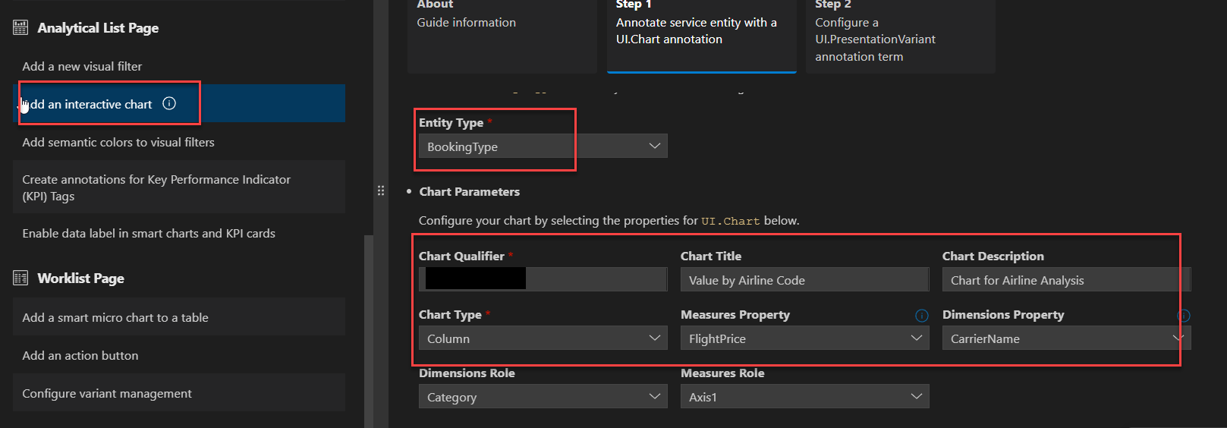
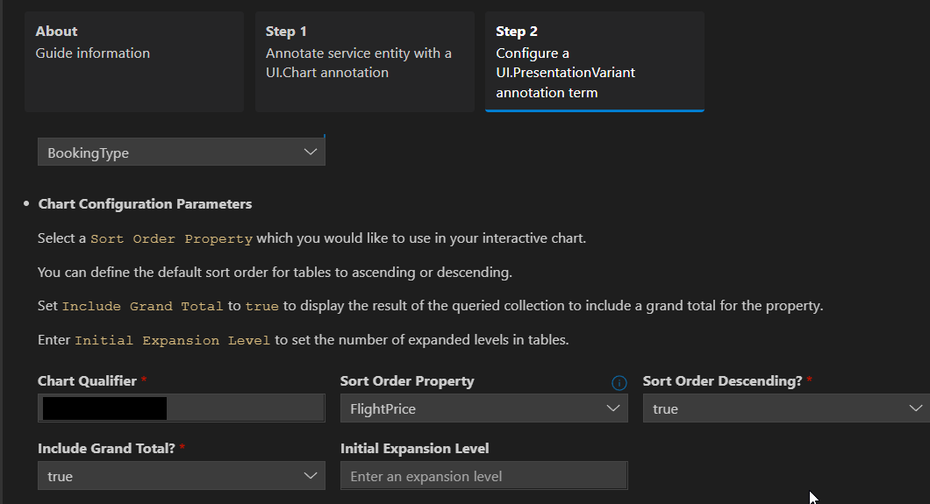

Slide 6
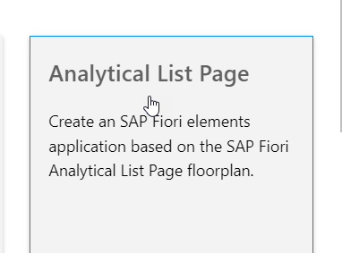
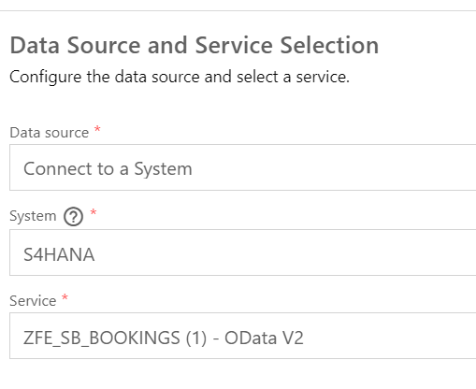
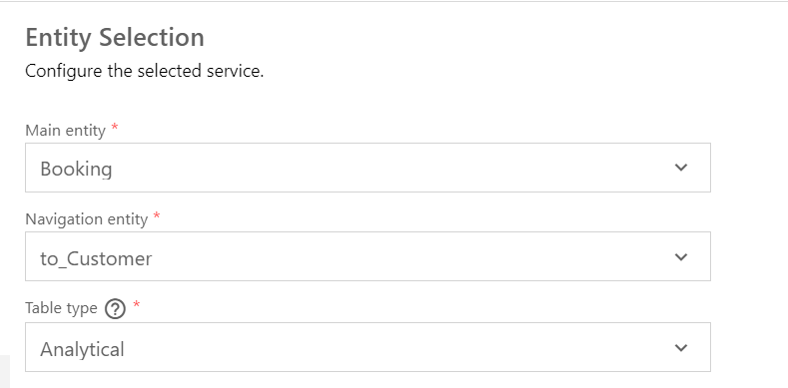
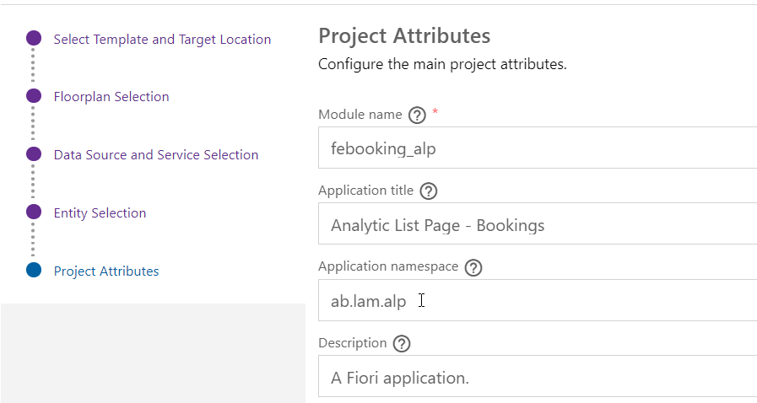

Slide 7
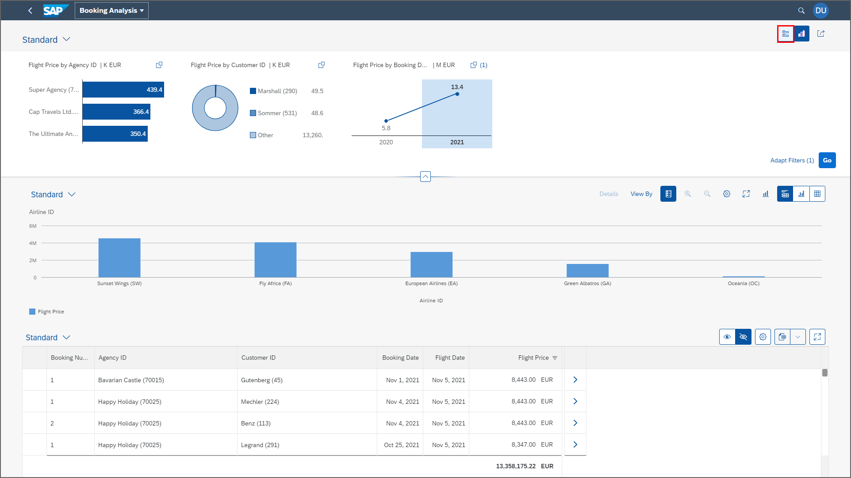
Create Analytic List Page

Slide 8
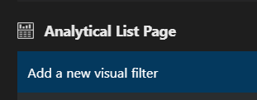
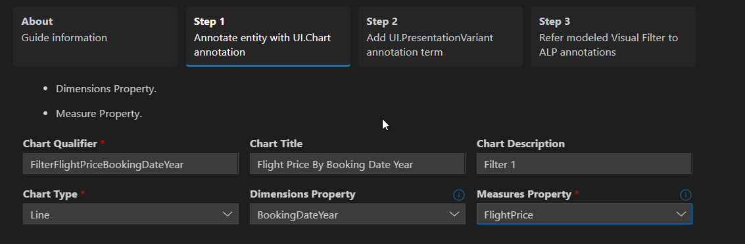
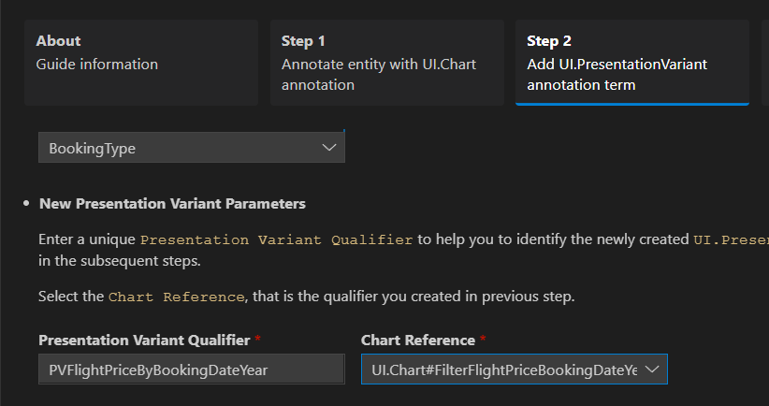
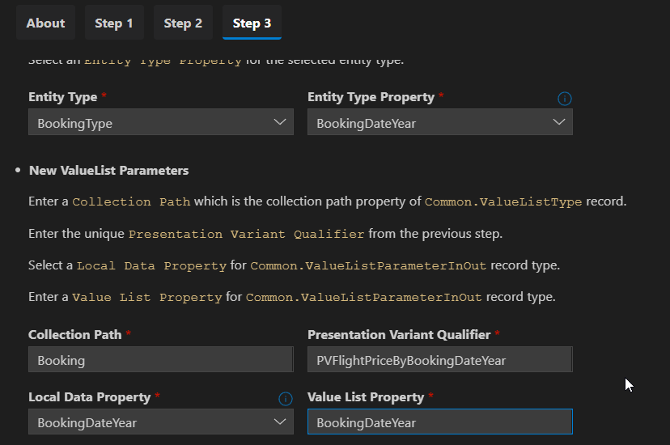

Slide 9
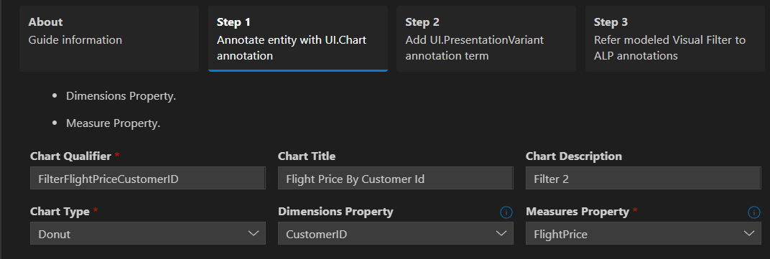
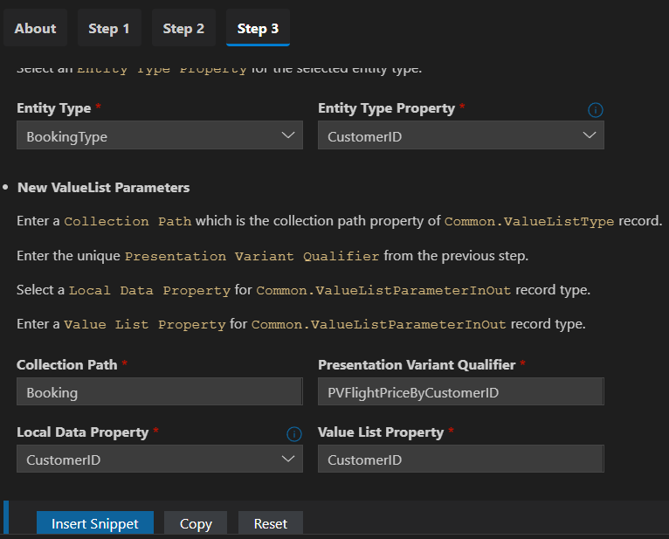
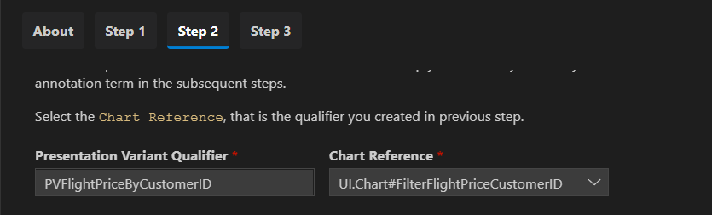

Slide 10
Fiori Elements - List Report Application
The list report offers powerful features for finding and acting on relevant data sets. It is often used as an entry point for navigating to the item details, which are usually shown on an object page.
List Report
Object Page

Slide 11

End of Day 26

Slide 12

Questions

Slide 13

Anubhav Oberoy

Slide 14


We’re committed to empower you to be
Most Desirable Resource
through powerful training solutions.
We build the workforce of the future.
260+
Corporate Clients
30,000+
Learners Trained
26000+
Learners Placed
FREE WEBINARS
Sign up for free webinars with industry experts every fortnight!
Enroll Now!
Contact us today!
https://anubhavtrainings.com/

Slide 15




More from AnubhavTrainings.com

Slide 16
Title
Content

